Slide 1
Resilience
Danube Water Conference
Monika Weber-Fahr The GWP Executive Secretary

Slide 2
Notes:
Poll Title: How far away from Vienna do you live? https://www.polleverywhere.com/multiple_choice_polls/M2tu0djauLNoEPXh6XFFa

Slide 3
Notes:
Poll Title: How many languages do you speak – well enough to explain the state of water quality in your country to someone else? https://www.polleverywhere.com/multiple_choice_polls/wwQCWfoRljaFhBman9bac

Slide 4
Resilience
Resilience
Risk
Building Resilience
Resilience in the Water Sector – 3 cases
Leadership

Slide 5
Resilience
Resilience
Risk
Building Resilience
Resilience in the Water Sector – 3 cases
Leadership

Slide 6
Notes:
Poll Title: What does "Resilience" mean? https://www.polleverywhere.com/multiple_choice_polls/75bnE54isKfUvHyP0j5A3

Slide 7
Resilience

Slide 8
Resilience

Slide 9
Resilience
Business resilience is the ability to rapidly adapt and respond to business disruptions, safeguard people and assets, while maintaining continuous business operations.

Slide 10
Notes:
Poll Title: Why would it matter for your organization to be resilient? Please order by priority! https://www.polleverywhere.com/ranking_polls/f3r9jk7mgrz6y6s5hMJln

Slide 11
Resilience
Business resilience is the ability to rapidly adapt and respond to business disruptions, safeguard people and assets, while maintaining continuous business operations.

Slide 12
Resilience
Resilience
Risk
Building Resilience
Resilience in the Water Sector – 3 cases
Leadership

Slide 13
What Risks for a Utility?
Financial
Operational
Environmental
Reputational
Health& Safety

Slide 14
Risk
Risk
Hazard
Exposure
Vulnerability
=

Slide 15
Risk
Risk
Hazard
Exposure
Vulnerability
=
Probability of losses from…
Hazard Type
Duration
Spatial extend
Elements at risk
e.g. people, businesses
How elements at risk would be effected..

Slide 16
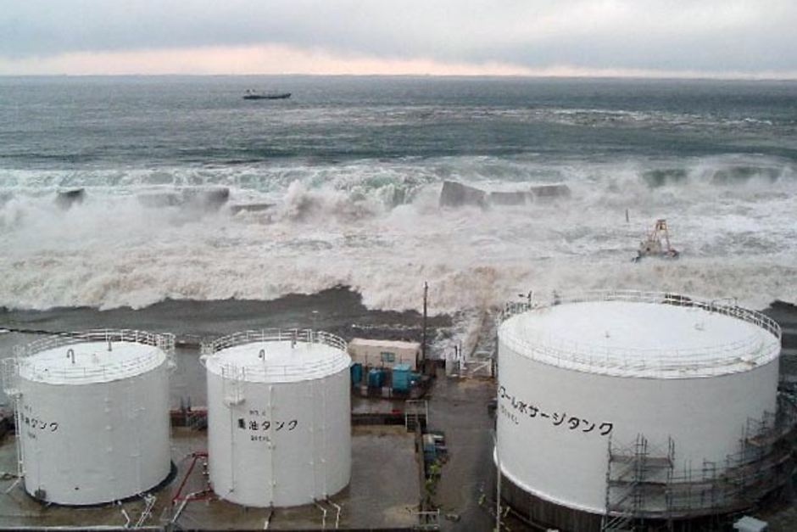
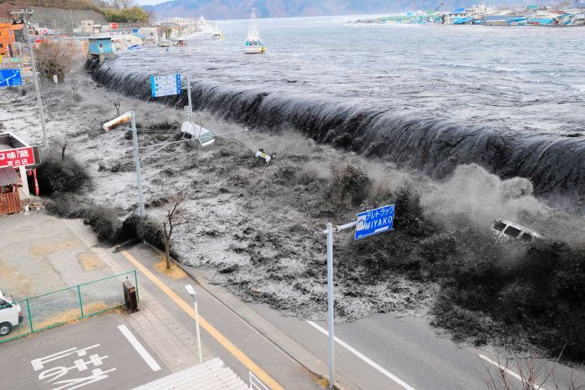
Risk: Fukushima 2011
(Source: Reuters)

Slide 17
Financial Risk: Black Friday
Black Friday, 9 May 1873, Vienna Stock Exchange.
The Panic of 1873 and Long Depression followed
Unknown artist

Slide 18
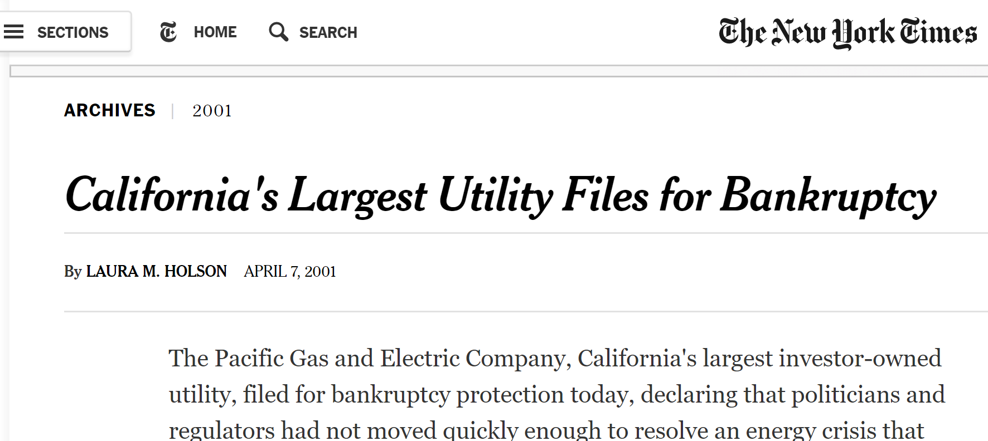
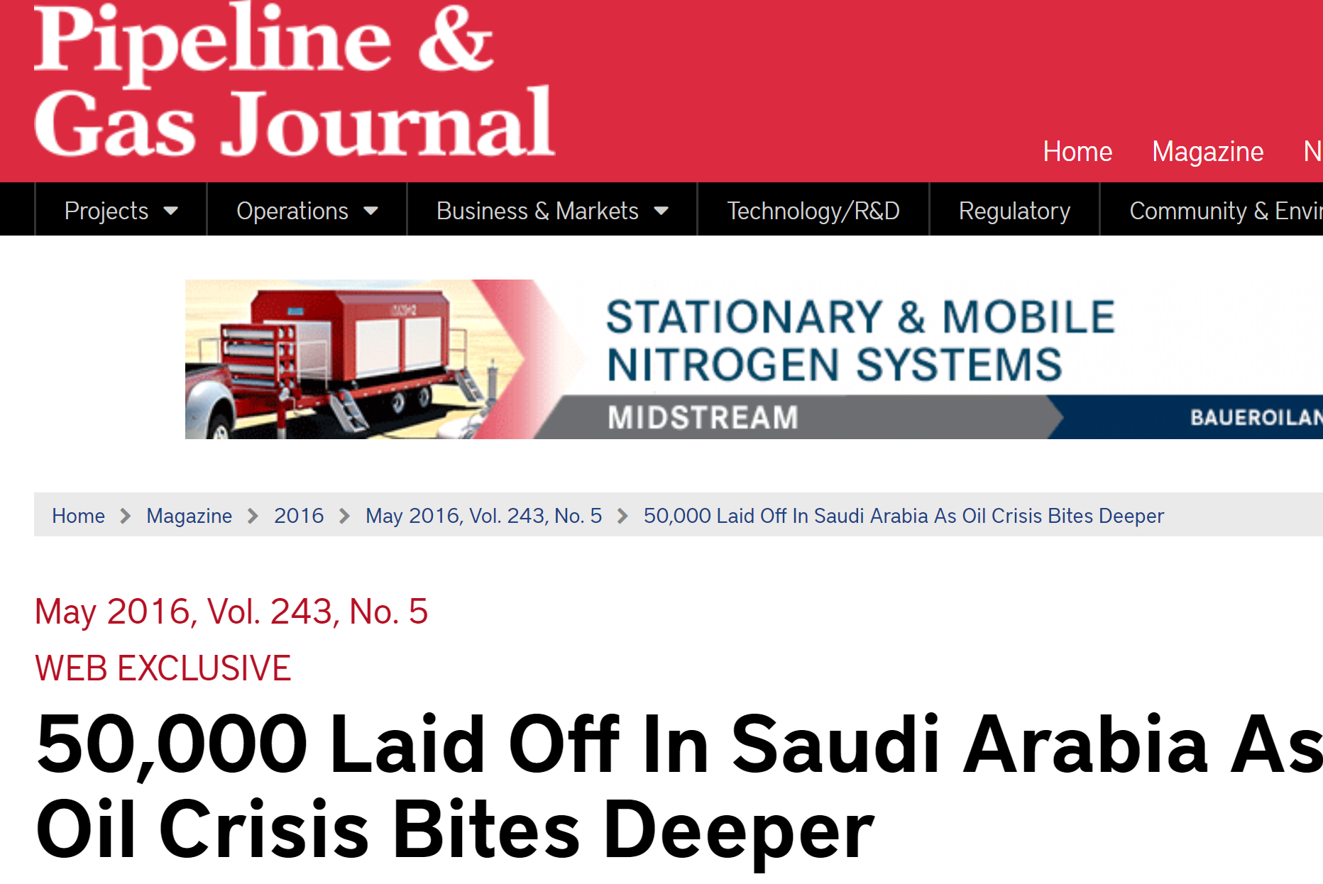
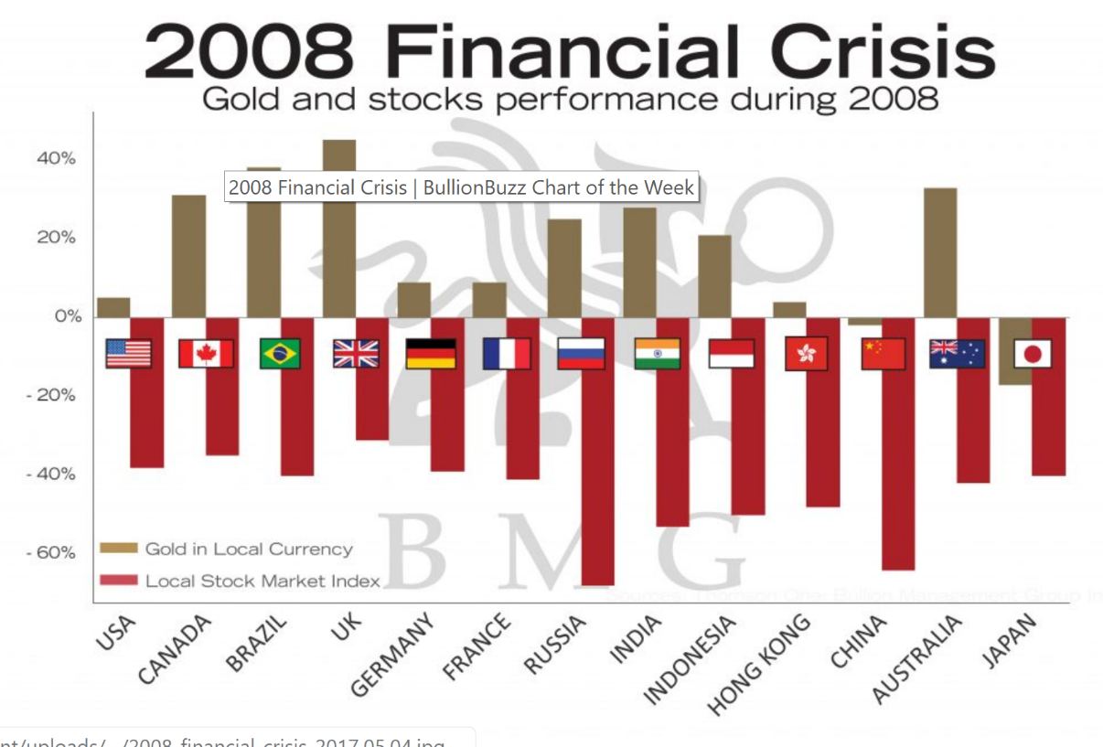

Slide 19
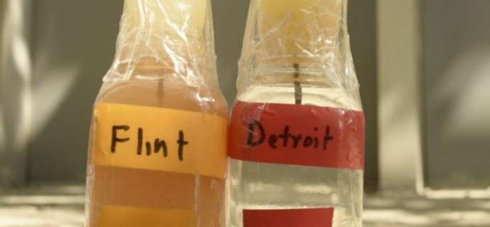

Slide 20
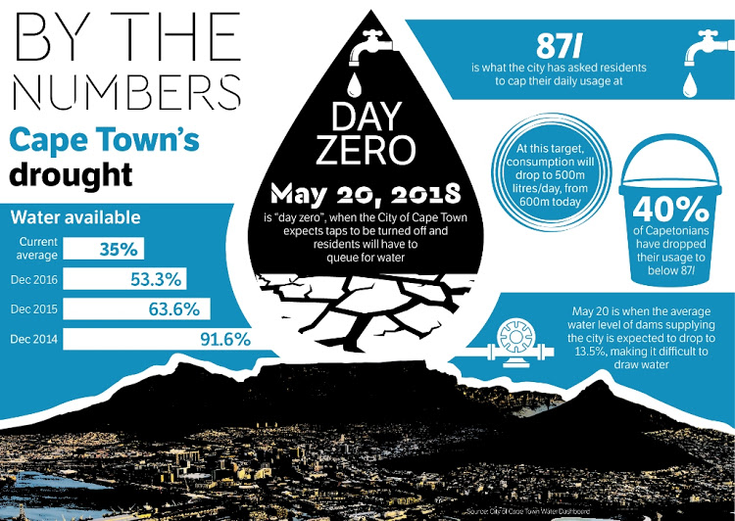

Slide 21
Notes:
Poll Title: Please order by priority – the Risks that you see as greatest https://www.polleverywhere.com/ranking_polls/2ztHKRZB1gPrHLeq5vDP4

Slide 22
Risk
Scale
Systemic nature of “Shock”
Risk
Hazard
Exposure
Vulnerability
=

Slide 23
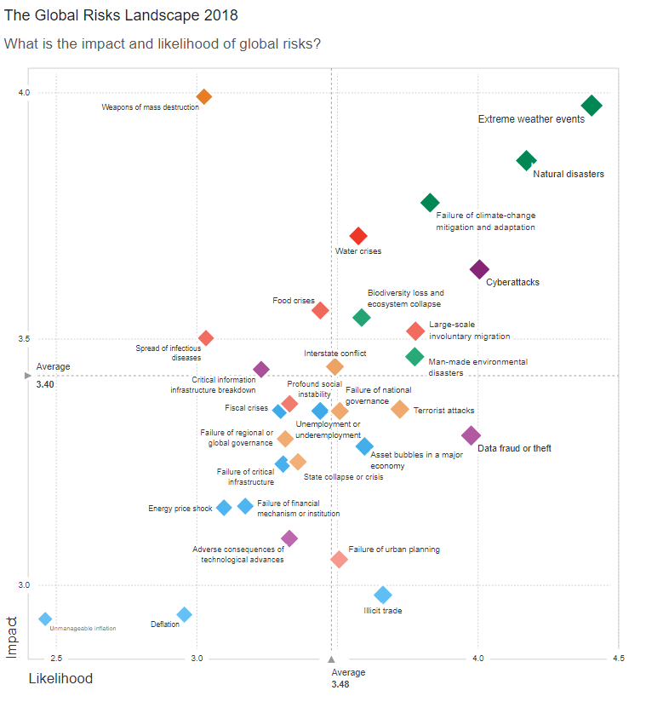
World Economic Forum Risk Survey
Perception of global business leaders of highest risks in terms of likelihood and severity

Slide 24
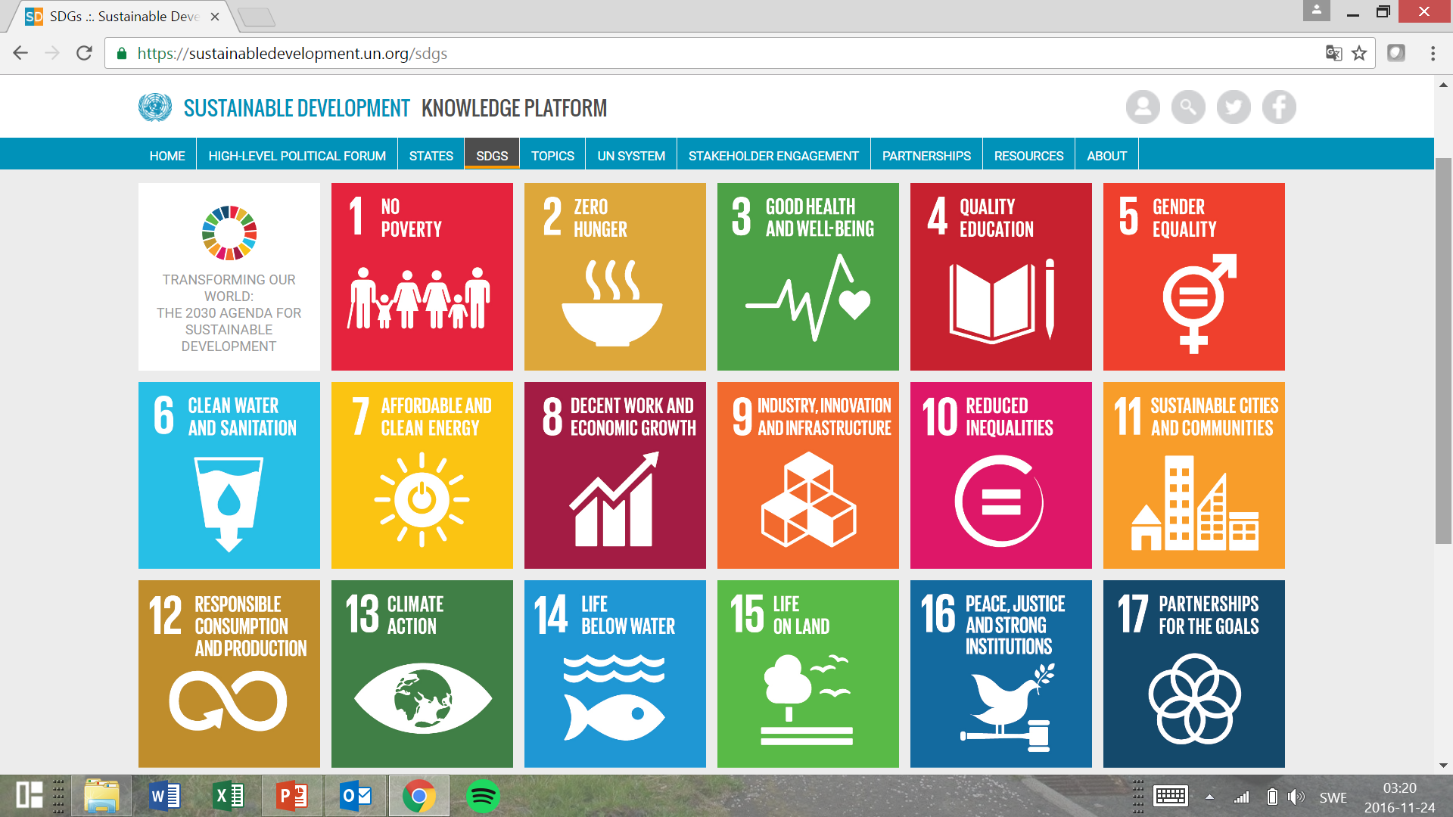
Global Growth and Prosperity aspirations

Slide 25
Notes:
Poll Title: Does water affect the Sustainable Development Goals? https://www.polleverywhere.com/multiple_choice_polls/Fu1e91aC1DKigFjvRL2eB

Slide 26
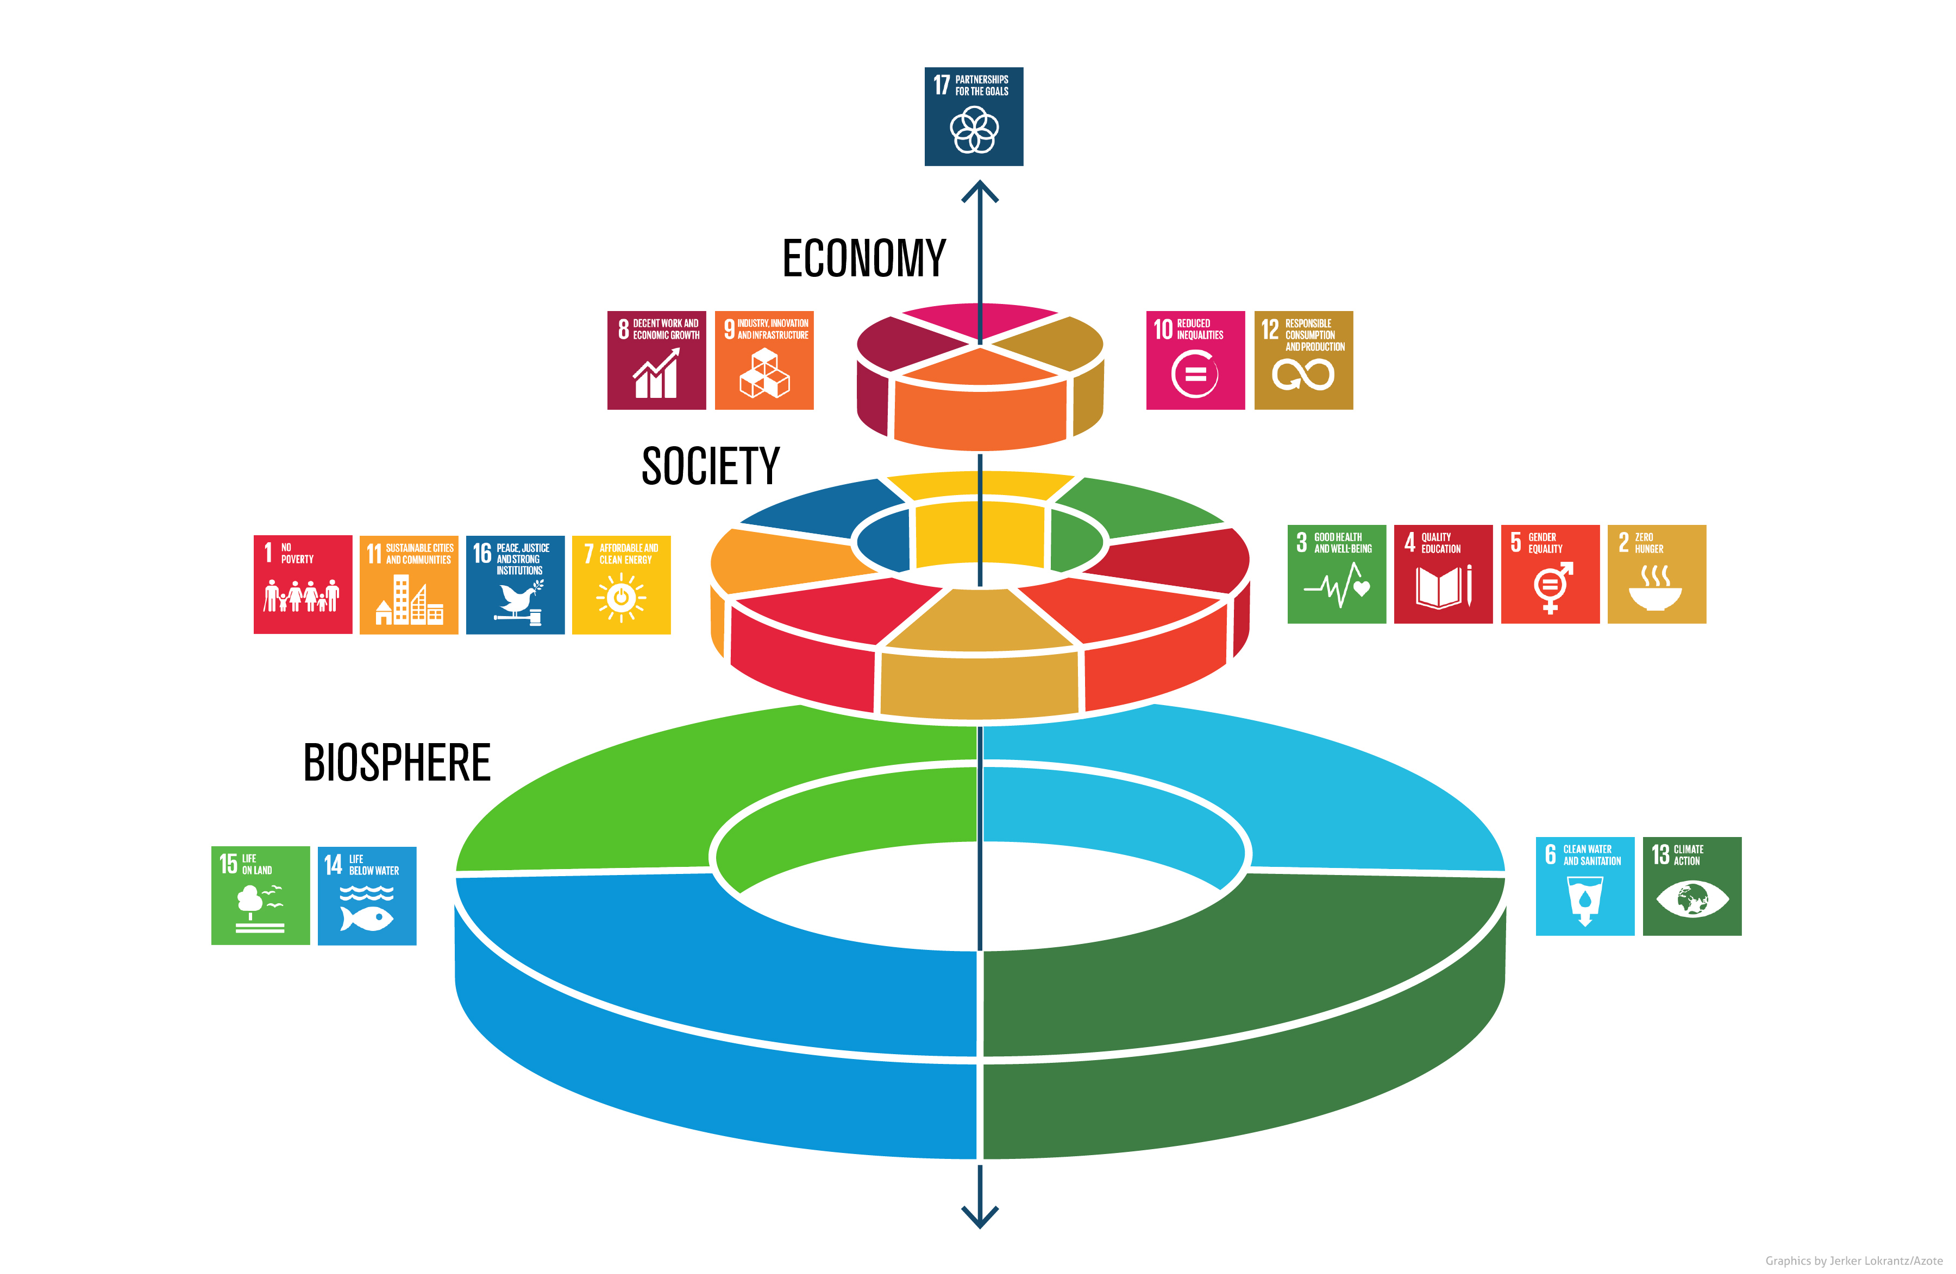
Water: Core to our ”system” of living

Slide 27
Resilience
Resilience
Risk
Building Resilience
Resilience in the Water Sector – 3 cases
Leadership

Slide 28
Normally: We work to manage risks
First:
Identify and Quantify
Then decide:
Terminate
Transfer
Treat
Tolerate

Slide 29
Building Resilience: Investing in the future

Slide 30
Transformational
Resilience
Before: Prepare
During: Adapt
After: Come back
Source: https://resilient.com/

Slide 31
Resilient Water Resources:
Through Integrated Water Resources Management

Slide 32
Urban Water Management Strategies: Towards Resilience
Sarni, Sperling, 2019

Slide 33
Resilience
Business resilience is the ability to rapidly adapt and respond to business disruptions, safeguard people and assets, while maintaining continuous business operations.

Slide 34
Resilience: Difficult Choices - Dilemmas

Slide 35
Notes:
Poll Title: Please order by priority of what matters most to you when you take a decision – e.g. to allocate financial resources: https://www.polleverywhere.com/ranking_polls/T6q4PIDXgZkk0E2j80HIk

Slide 36
Resolving Dilemmas

Slide 37
Resilience
Resilience
Risk
Building Resilience
Resilience in the Water Sector – 3 cases
Leadership

Slide 38
Cyber Safety

Slide 39
Cyber attack risk
Source: Privacyrisksadvisors.com

Slide 40
Integrity

Slide 41
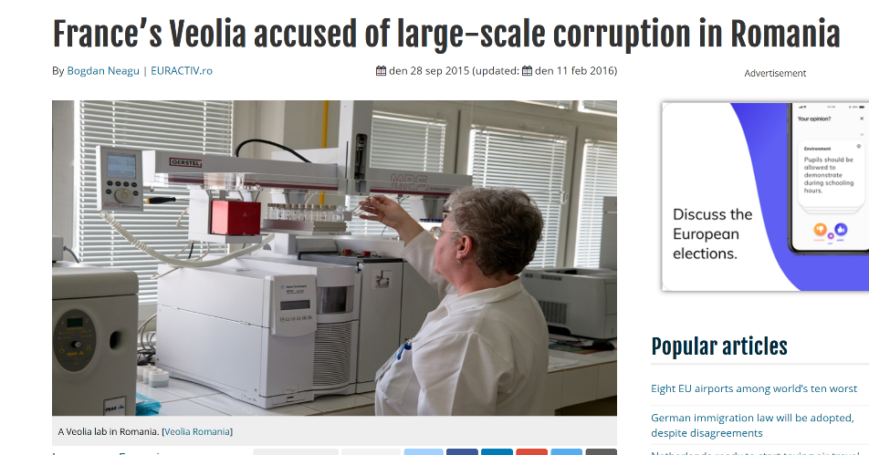
Integrity Risks

Slide 42
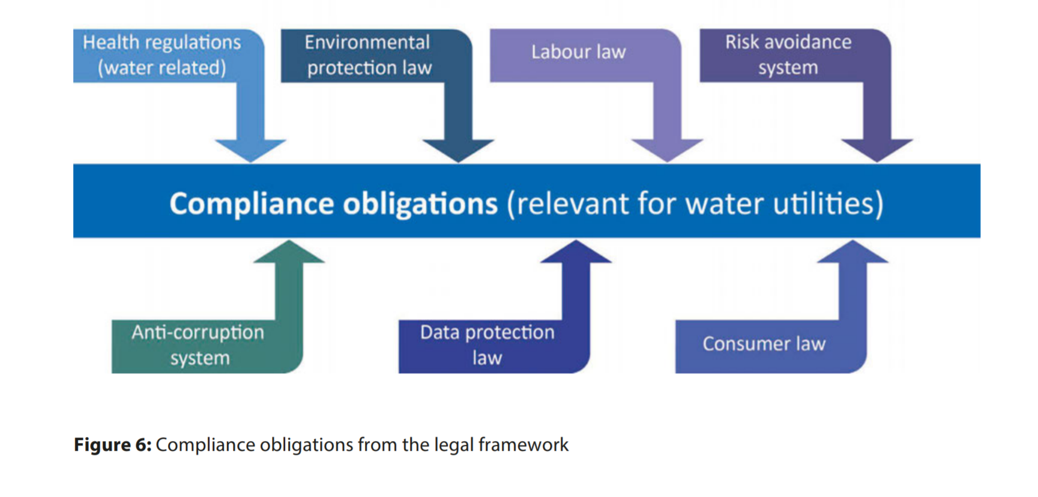
Legal Complexity: Can create vulnerability

Slide 43
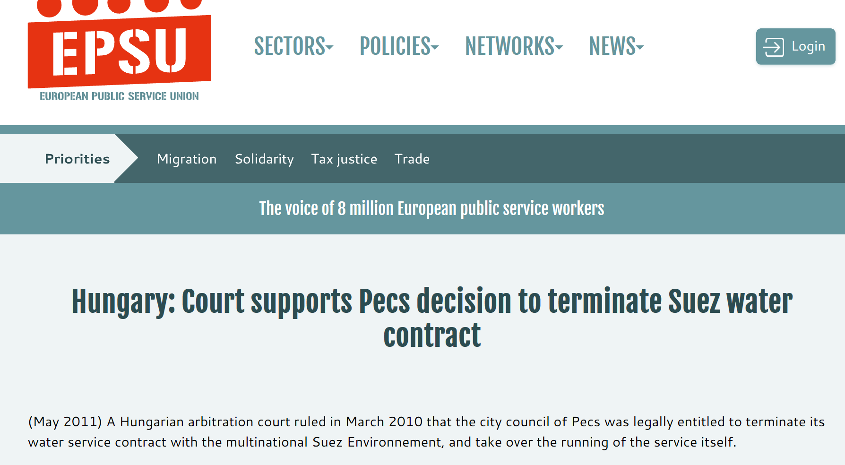
How vulnerable are we?

Slide 44
Resilience against graft and corruption
Strong Culture of Commitment and Service –
built on shared values and lived by the Executives
From: Waterintegrity.org

Slide 45
Water Quantity and Quality

Slide 46
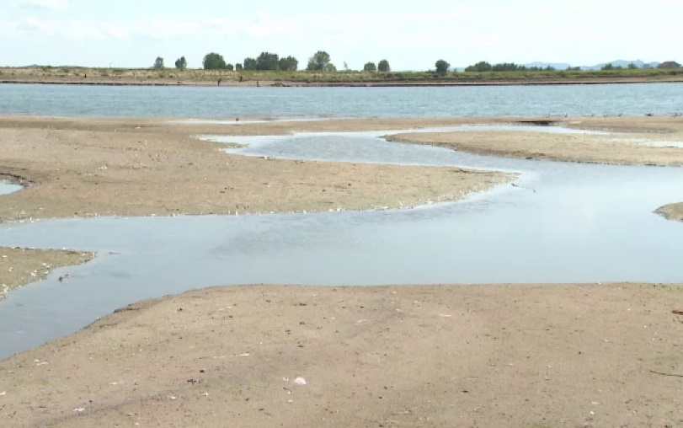
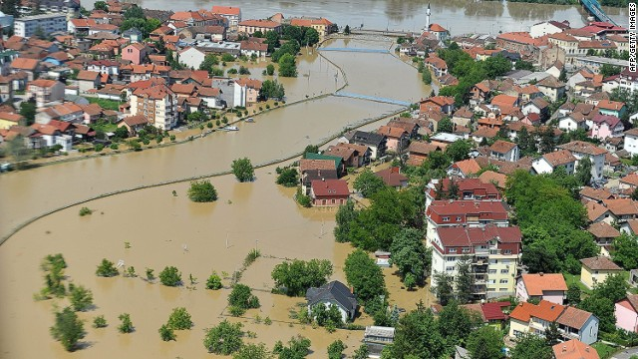
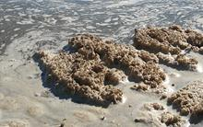
Water Resources: Environmental Risks are becoming Operational Risks
Too little Too much Too dirty
Is the region resilient to extremes?
Recent droughts (2003, 2007, 2012, 2013, 2015, 2017, 2018).
2017 drought: total damage is estimated at around 110 million EUR in Slovenia and 128 million EUR in Croatia.
Floods in South East Europe in in 2014: Assessments of the damage range up to 3.5 billion € for Serbia, Bosnia and Herzegovina
Lack of sanitation in small settlements in the Danube: 30% of population lives in settlements with less than 2000 inhabitants (= 42 million people) - 9% of these are so far connected to WWTP (GWP, 2011)
PAP
Gazeta.pl
PAP
Gazeta.pl
Wyborcza.pl
WWF Polska

Slide 47
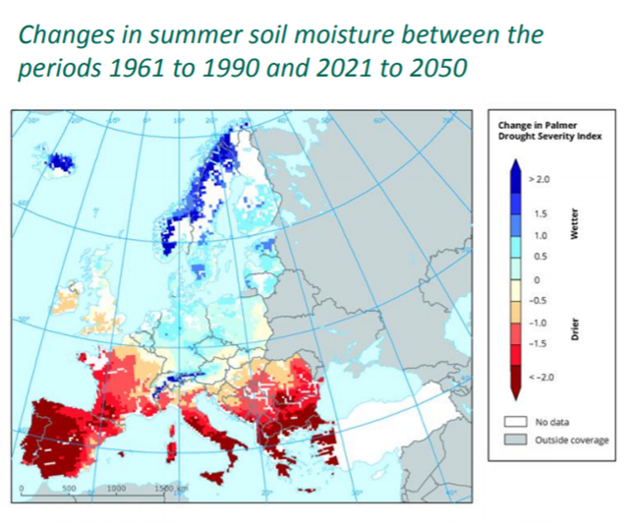
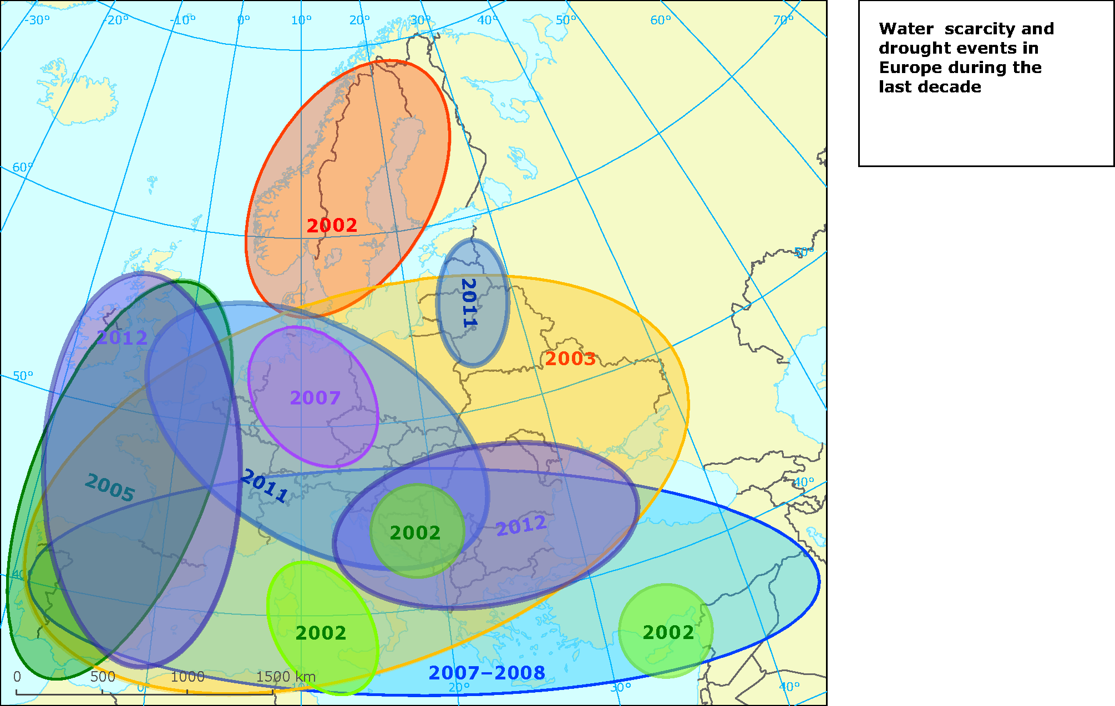
Drought: the most costly natural disaster in the Danube Region
Summer soil moisture: In Danube Region averages to decrease by 17%
Dry periods to become three times as likely
Past droughts 2002 -2017
2017
2015
Notes:
Drought studies have identified drought hotspots in the Mediterranean and southern Europe, the Carpathians and the Balkans.
Regional climate models for Europe project a decrease in summer soil moisture of 17 % on average, and by 30 % in June for the period of 2071-2100.
Dry periods are expected to occur 3 times more often at the end of the current century and to last longer by 1 to 3 days compared to the period of 1971-2000.

Slide 48
Drought is has becoming the most costly natural disaster in the Danube Region
Drought is still considered to a to be a rare phenomenon. Probably for this reason drought is still not getting enough attention at different levels in the region (political, operational, general public etc.)

Slide 49
Climate Impacts in the Danube Region
Source (European Environment Agency 2017)

Slide 50
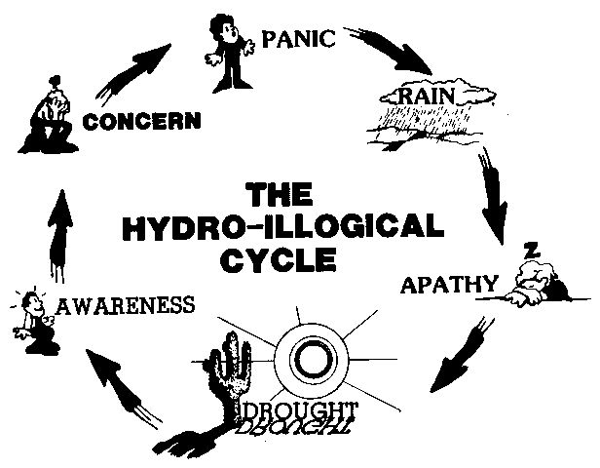
Drought: Not well managed for a reason…

Slide 51
Drought Resilience is possible
Joint initiative of Global Water Partnership (GWP) and WMO
Launched in 2013 at the High-Level Meeting on National Drought Policies (HMNDP) in Geneva
IDMP in Central and Eastern Europe started in March 2013 (1st Phase) & 2nd Phase 2017 – 2019
Regional Drought Resilience – by improving capacity for integrated drought management

Slide 52
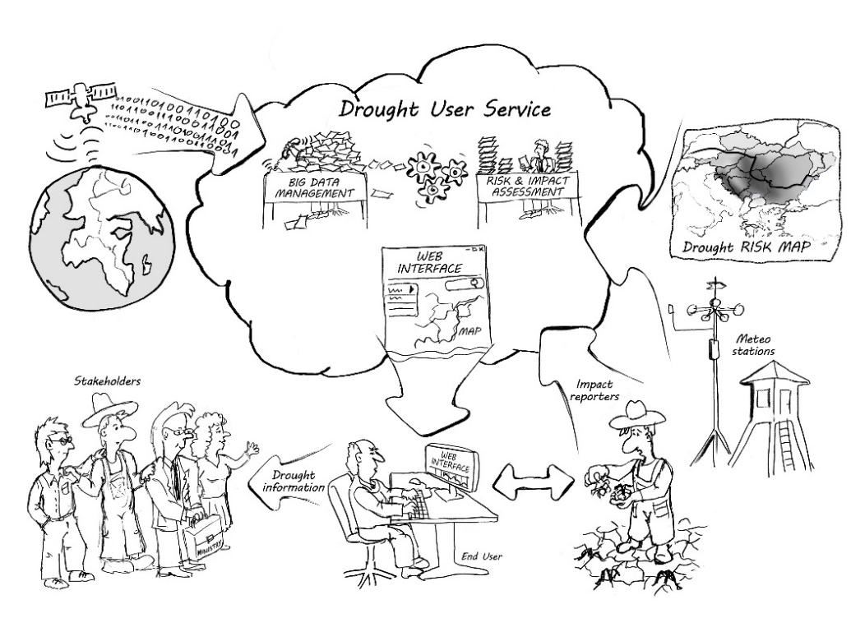
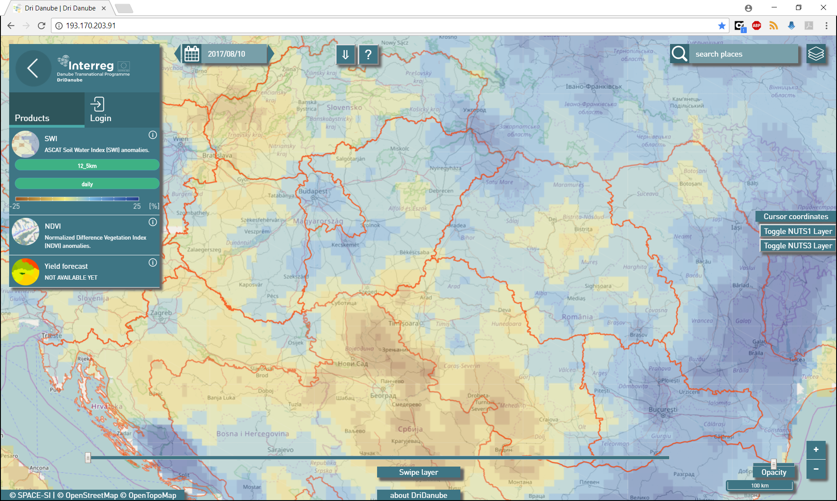
First: Monitoring and Assessment
Drought User Service
An innovative tool integrating all available data, including large volume of remote sensing products and serving the authorities to monitor, forecast and respond during drought development faster and with higher precision
Unification and cross-border coherence of drought Risk and Impact assessments.
Establishment of networks of reporters as additional source of information for drought impacts in agriculture.

Slide 53
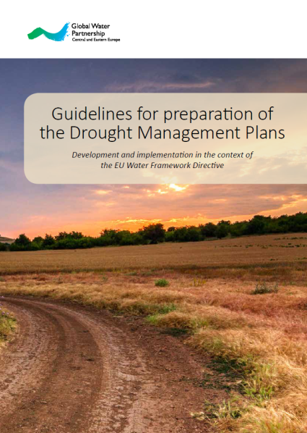
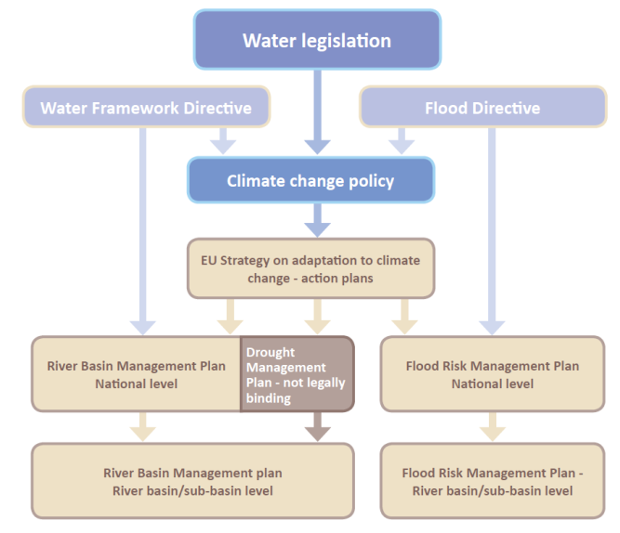
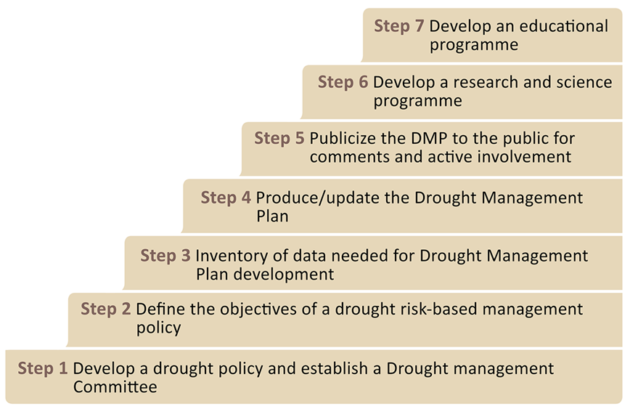
Second: Drought Resilience as part of Decision Making

Slide 54
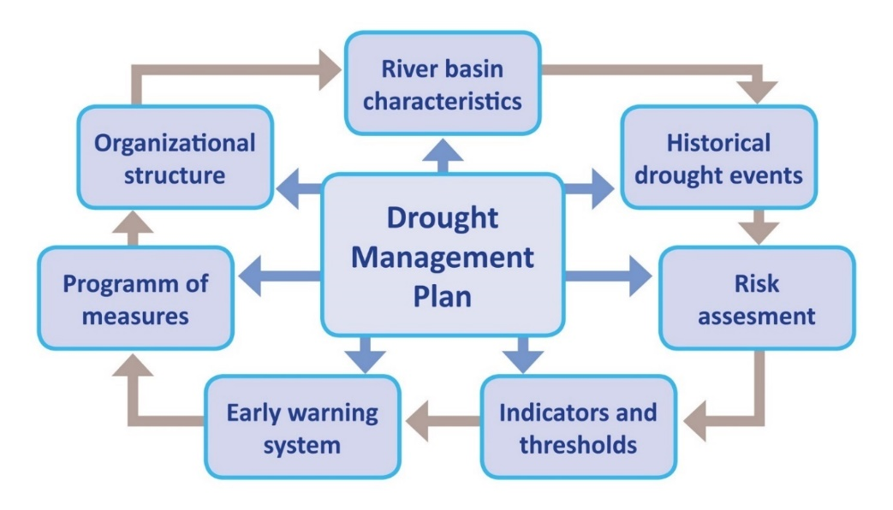
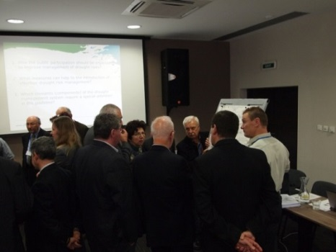
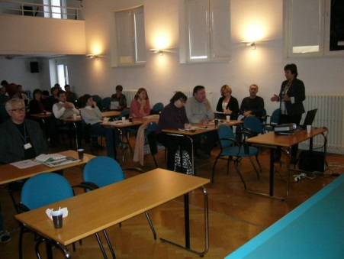
Political Will is essential for Resilience
Main challenges - lack of political will to solve the problem – drought was not considered as a relevant issue.
Cooperation with national governments to help them to incorporate drought management issues into their national programs, policies and plans
National Consultation Dialogues –
acceptance at the policy level
Slovak National Drought Action Plan
(Finalized in March 2018)
inter-ministerial working group
Inspired by the Guidelines
Strategic framework: Water Plan of the Slovak Republic (update 2015); SDGs

Slide 55
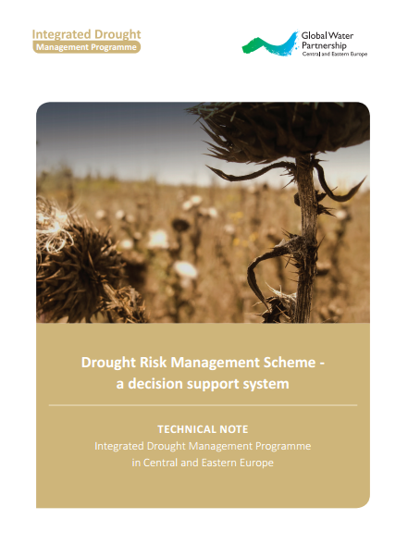
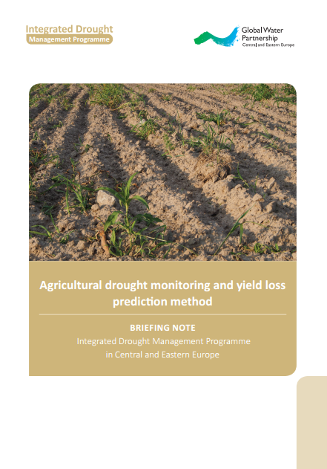
With Political Will: Capacity can follow
Natural Small Water Retention Measures
Increasing soil water holding capacity
Drought impact on forest ecosystems
Remote sensing agricultural drought monitoring methods
Updating agricultural drought monitoring and forecasting in Ukraine and Moldova

Slide 56
Critical for Resilience: Regional Cooperation
IDMP CEE - connections of drought initiatives in the region
EU Strategy for the Danube Region (cooperation with Priority Area 5 on Environmental Risks)
International Commission for the Protection of the Danube River (ICPDR Climate Change Adaptation Strategy)
International Sava River Basin Commission
Drought Management Centre for Southeastern Europe
Carpathian Convention (Climate Change Adaptation strategy, Climate-ADAPT)
European Drought Observatory (JRC)
World Meteorological Organization (WMO)
Change we want to make

Slide 57
Resilience
Resilience
Risk
Building Resilience
Resilience in the Water Sector – 3 cases
Leadership

Slide 58
Resilient Leadership
Leadership to build Resilience

Slide 60
Resilient leaders

Slide 61
Leadership in the Water Sector is often tough
Perspectives: Making Water matter to others
Emotional: Tough Choices
Connections: Stakeholders
Physical: Multiple Demands

Slide 63
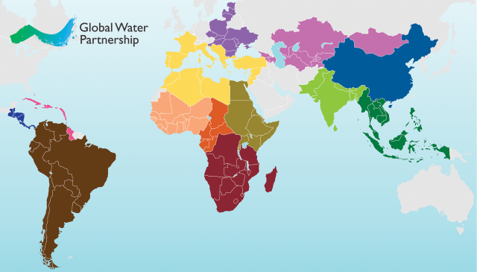
Resilient Leaders around the World
The Global Water Partnership: A multi-stakeholder action network that supports countries in their efforts to implement more equitable and sustainable management of water resources. Our network spans 13 regions with more than 65 country water partnerships and over 3,000 institutional Partners in 180+ countries.

Slide 64
Resilient Leadership: Personal Investment
Remain vulnerable enough to feel for and with others
Become strong enough to live with uncertainty and ambiguity
Learn to grow, not crumble, through adversity
Take time for perspective in the moment and the longer term
Draw on and re-confirm your values and purpose

Slide 65
Notes:
Poll Title: Please sort by priority: What motivates you most in making sure your utility is resilient to future shocks? https://www.polleverywhere.com/ranking_polls/NBJo2W7y3jqeNwV0c7NSu

Slide 66
Thank You

